Slide 1
Fueling the Future: The Power of Hydrogen Energy and Fuel Cells

Slide 2
What is Hydrogen Energy?
Basics of electrochemical
Fuel Cell Technology
polymer membrane electrolyte fuel cells
solid oxide fuel cells
hydrogen production and storage
Advantages of Hydrogen Energy
Challenges of Hydrogen Energy
Applications of Hydrogen Energy
The Future of Hydrogen Energy
Conclusion

Slide 3

What is Hydrogen Energy?
Hydrogen energy is a clean and efficient form of power that harnesses the energy stored in hydrogen molecules. When hydrogen is burned or combined with oxygen in a fuel cell, it produces electricity and water vapor as byproducts. This process is emission-free and has the potential to revolutionize the way we generate and consume energy. Hydrogen energy is still a relatively new technology, but it has already shown great promise in a variety of applications. It can be used to power cars, buses, and even homes and buildings. As the world looks for ways to reduce its dependence on fossil fuels and combat climate change, hydrogen energy is emerging as a leading contender.

Slide 4
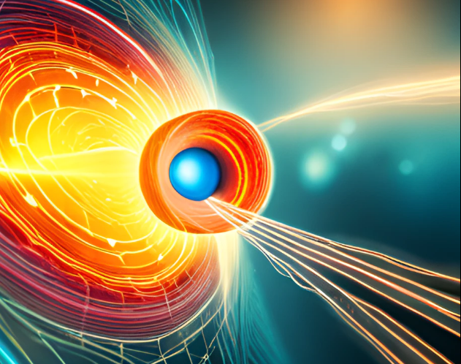
Basics of electrochemical
Electrochemical reactions involve the transfer of electrons between different substances. In the case of hydrogen energy, this process occurs in a fuel cell, which contains an anode, a cathode, and an electrolyte. When hydrogen gas is introduced to the anode, it is split into protons and electrons. The protons pass through the electrolyte to the cathode, while the electrons are forced to flow through an external circuit, generating electricity.
This process is highly efficient, producing much more energy than traditional combustion engines. It also produces zero greenhouse gas emissions, making it a sustainable and environmentally friendly alternative to fossil fuels.

Slide 5
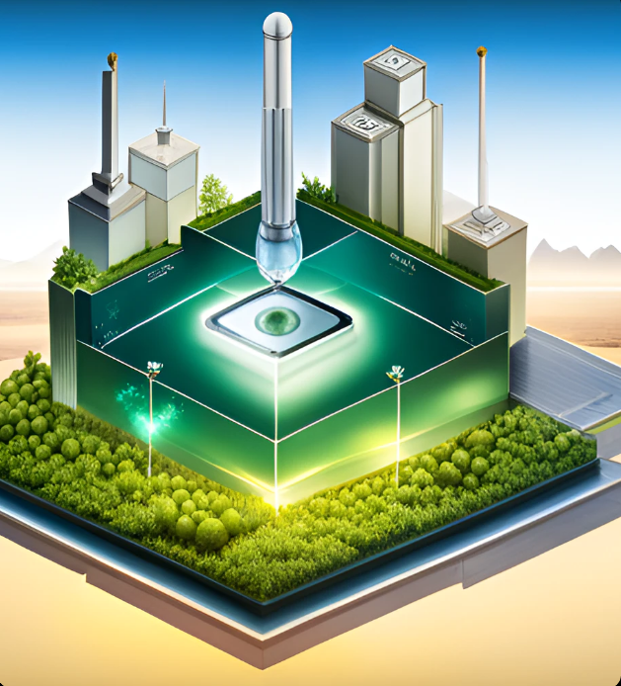
What is a Fuel Cell?
A fuel cell is an electrochemical device that converts the chemical energy of a fuel, such as hydrogen, directly into electricity. The basic components of a fuel cell include an anode, a cathode, and an electrolyte.
When hydrogen is supplied to the anode of a fuel cell, it is split into protons and electrons. The protons pass through the electrolyte to the cathode, while the electrons travel through an external circuit, generating electricity. At the cathode, the protons and electrons combine with oxygen to form water, which is the only byproduct of the reaction.

Slide 6

Polymer Membrane Electrolyte Fuel Cell
The Polymer Membrane Electrolyte Fuel Cell (PEMFC) is a type of fuel cell that uses a polymer membrane as its electrolyte. PEMFCs are lightweight, efficient, and have a high power density, making them ideal for use in transportation applications.
However, PEMFCs require pure hydrogen as their fuel source, which can be difficult and expensive to produce. In addition, the polymer membrane is sensitive to impurities, which can reduce the efficiency of the fuel cell.

Slide 7

solid oxide fuel cells
Solid oxide fuel cells (SOFCs) are another type of fuel cell that use a solid oxide electrolyte to generate electricity. SOFCs operate at high temperatures, typically between 800 and 1,000 degrees Celsius, which allows them to use a wider range of fuels than other types of fuel cells.
SOFCs are currently being used in a variety of applications, from providing backup power for buildings to generating electricity from waste gases produced by industrial processes. However, their high operating temperature can make them less efficient than other types of fuel cells, and they require careful management to prevent thermal stress and degradation.

Slide 8

hydrogen production and storage
One of the challenges of using hydrogen energy is producing and storing enough hydrogen to meet demand. Hydrogen can be produced from a variety of sources, including natural gas, biomass, and water. However, each method has its own advantages and disadvantages, and there is no one-size-fits-all solution for hydrogen production.
Similarly, storing hydrogen safely and efficiently is still a major challenge. Hydrogen is a highly flammable gas, and it requires special infrastructure to transport and store it. Researchers are exploring new methods for storing hydrogen, such as using metal hydrides or carbon nanotubes, but these technologies are still in the early stages of development.

Slide 9

Coal-Fired Plants and Integrated Gasifier Fuel Cell System
In the world of energy production, coal-fired plants have long been a staple. However, these plants are notorious for their negative impact on the environment. That's where integrated gassifier fuel cell systems come in. By using a process that converts coal into a gas, these systems can produce electricity with significantly lower emissions.
The process starts by breaking down coal into a gas mixture, which is then fed into a fuel cell. The fuel cell uses this gas to produce electricity, heat, and water. This technology has the potential to revolutionize the way we think about coal-fired power plants, making them more efficient and environmentally friendly.

Slide 10

Advantages of Hydrogen Energy
Hydrogen energy offers a number of key advantages over traditional fossil fuels. First and foremost, it is a clean and sustainable source of energy that produces zero greenhouse gas emissions. This makes it an ideal solution for a world that is increasingly concerned with climate change and environmental sustainability.
In addition, hydrogen energy is highly efficient, producing much more energy than traditional combustion engines. It is also versatile and can be used in a wide range of applications, from powering cars and buses to providing backup power for buildings. Finally, hydrogen has the potential to reduce our dependence on fossil fuels and create a more sustainable energy future for everyone

Slide 11

Challenges of Hydrogen Energy
Despite its many advantages, hydrogen energy still faces a number of challenges that must be overcome before it can be widely adopted. One of the biggest challenges is the high cost of production. Producing hydrogen gas requires a significant amount of energy, and current methods are often inefficient and expensive.
Another challenge is the lack of infrastructure for storing and transporting hydrogen. While there are some hydrogen refueling stations and storage facilities in operation today, they are few and far between. Finally, there is the issue of public perception. Many people are still skeptical of hydrogen energy and view it as a risky or unproven technology.
However, researchers and industry leaders are working hard to address these challenges and make hydrogen energy a viable and attractive option for consumers and businesses alike.

Slide 12

Applications of Hydrogen Energy
Hydrogen energy is already being used in a variety of innovative and exciting ways. One of the most promising applications is in transportation, where hydrogen fuel cells are being used to power cars, buses, and even trains. These vehicles are quiet, efficient, and emission-free, making them an ideal solution for reducing air pollution and greenhouse gas emissions.
Hydrogen energy is also being used to provide backup power for buildings and other critical infrastructure. In areas that are prone to power outages or natural disasters, hydrogen fuel cells can provide a reliable source of electricity when the grid goes down. Finally, researchers are exploring new applications for hydrogen energy in fields such as aviation, space travel, and even agriculture.

Slide 13

The Future of Hydrogen Energy
Hydrogen energy has the potential to transform the energy industry and contribute to a more sustainable future. With ongoing research and development, hydrogen energy can become a viable alternative to traditional fossil fuels, reducing our dependence on foreign oil and creating new jobs in the energy industry.
However, realizing this potential will require continued investment and support from governments, businesses, and individuals. By working together to develop and promote hydrogen energy, we can create a cleaner, more sustainable future for generations to come.

Slide 14

Conclusion
In conclusion, hydrogen energy and fuel cells hold great promise for the future of clean energy. With the potential to power everything from cars to entire cities, this technology could revolutionize the way we live and work. While there are still challenges to be overcome, such as cost and infrastructure, the benefits of hydrogen energy cannot be ignored.
As we look towards a more sustainable future, it is essential that we explore all possible avenues for clean energy. Hydrogen energy and fuel cells offer an exciting opportunity to do just that. By investing in this technology and supporting its development, we can help create a better world for ourselves and future generations.

